Slide 1



Creating Technical Posters
COMP2x0: Individual Specialist Computing Project
BA Game Development
BSc Computing for Games

Slide 2
Creating Technical Posters
Tends to be a bit of a challenge for students
Across all 3 years of the degree programme

Slide 3
Creating Technical Posters
Tends to be a bit of a challenge for students
Across all 3 years of the degree programme
Have a look at previous student feedback to see ‘issues’
contains a flowchart describing behaviour and a hard to read blueprint screenshot
It features several blueprints but would benefit from some UML flowcharts / state diagrams to describe the implemented behaviours
consists largely of hard to read blueprints with little explanation
contained little detail and some hard to read screenshots of code
almost completely devoid of any technical information
It was difficult to see what the poster was trying to explain

Slide 4
Creating Technical Posters
Tends to be a bit of a challenge for students
Across all 3 years of the degree programme
Scope to vacuum up marks on your degree
Technical posters carry significantly more marks / effort than anything else does
Potential to shift your degree up by a classification by doing ‘good’ posters
Don’t leave them ‘til the last minute
I heard a few horror stories about people doing them on the morning of presentation
The law of diminishing returns is your friend

Slide 5
Creating Technical Posters
Technical posters, why?
We’re not going to make them for interviews, so why bother getting good at them
Technical posters are a vehicle for you to develop your skills in articulating technical problems and solutions using ‘industry standard’ terms, tools and techniques.
How technical posters help in interviews
You’ll be asked to talk about problems you’ve solved and how you solved them
You need to be able to articulate that into UML, design patterns, pseudo code & process
You may even end up drawing things on a whiteboard

Slide 6
Creating Technical Posters
Making good posters
Let’s think about this from 5Ws&H perspective
Who are they for
What is their purpose
When do you do them
Where do you do them
Why do you do them
How do you do them

Slide 7
Creating Technical Posters
Making good posters
Let’s think about this from 5Ws&H perspective
Who are they for
Lecturing staff to assess your ability to articulate technical problem solving
You to develop your ability to articulate technical problem solving
What is their purpose
When do you do them
Where do you do them
Why do you do them
How do you do them

Slide 8
Creating Technical Posters
Making good posters
Let’s think about this from 5Ws&H perspective
Who are they for
What is their purpose
Demonstrate you ability to solve interesting technical problems
A vehicle for you to articulate how you solve interesting technical problems
When do you do them
Where do you do them
Why do you do them
How do you do them

Slide 9
Creating Technical Posters
Making good posters
Let’s think about this from 5Ws&H perspective
Who are they for
What is their purpose
When do you do them
After you have solved interesting technical problems
Preferably not just before their presentation
Where do you do them
Why do you do them
How do you do them

Slide 10
Creating Technical Posters
Making good posters
Let’s think about this from 5Ws&H perspective
Who are they for
What is their purpose
When do you do them
Where do you do them
Present in an environment where there are lots of presentations to be done
Get interest quickly
Show clear ideas and a clear process of problem solving
Why do you do them
How do you do them

Slide 11
Creating Technical Posters
Making good posters
Let’s think about this from 5Ws&H perspective
Who are they for
What is their purpose
When do you do them
Where do you do them
Why do you do them
Within the course: to develop your skills at presenting problem solving
Outside of the course: to demonstrate interesting solutions to challenging problems
How do you do them

Slide 12
Creating Technical Posters
Making good posters
Let’s think about this from 5Ws&H perspective
Who are they for
What is their purpose
When do you do them
Where do you do them
Why do you do them
How do you do them
...

Slide 13
Creating Technical Posters
Making good posters
The heart of a good poster is a good story
A problem that needed to be addressed
The solution that worked
The outcome and its impact

Slide 14
Creating Technical Posters
Making good posters
The heart of a good poster is a good story
A problem that needed to be addressed
The solution that worked
The outcome and its impact
It needs to ‘fit’ on a reasonable sized piece of paper
Can’t be a really big problem
Or a really complex solution
Or an outcome with lots of caveats

Slide 15
Creating Technical Posters
Making good posters
The heart of a good poster is a good story
A problem that needed to be addressed
The solution that worked
The outcome and its impact
It needs to ‘fit’ on a reasonable sized piece of paper
Can’t be a really big problem
Or a really complex solution
Or an outcome with lots of caveats
→ A Goldilocks problem
Not too big, not too small, not too complex & not too trivial

Slide 16
Creating Technical Posters
Making good posters
The heart of a good poster is a good story
A problem that needed to be addressed
We know there are lots of problems that need to be addressed in game development, some are more interesting to present than others
For a poster,
do you have problems that will make people happy when they are fixed?
do you have problems that required ‘interesting’ technical solutions?
Etc
Can you articulate it in not very much writing?
Ultimately:
What is the problem
Why is it an issue

Slide 17
Creating Technical Posters
Making good posters
The heart of a good poster is a good story
The solution that worked
Writing your poster towards the end of development (not the morning of the presentation), you will have a good handle on:
What ultimately worked
The steps you had to go through
The dead ends and blind alleys you encountered
The key features of you solution’s form & function, and data model
Ultimately:
This is about articulating detail
Enough detail to express what’s important
Ignore what’s not important

Slide 18
Creating Technical Posters
Making good posters
The heart of a good poster is a good story
The outcome and its impact
Hopefully, your solution worked and feature ‘X’ was added to the game
However, does your solution provide impact beyond the scope of adding a feature to a game or removing a work item from a backlog.
Ultimately:
This is about closing the story
Did your solution meet its goals
Did it add value
Does it open up new areas of interest / approaches
Does it have a positive impact for co-workers

Slide 19
Creating Technical Posters
Making good posters
Here’s my conceptual model of good posters
There’s five parts:
Name & Title
Problem definition
Solution description
Modelling tools
Outcome and impact
It’s conceptual, so posters don’t have to look like this, but they should use the parts
Apart from all the modelling tools, just use what makes sense for your poster. Don’t use all of them
TITLE
NAME
WHAT IS THE PROBLEM
WHY IS IT AN ISSUE
WHAT IS THE SOLUTION
USE-CASES
CLASS HIERARCHY
STATE MACHINE
FLOW CHART
PSEUDO CODE
SCREEN CAPS
WHAT WORKED WELL
WHAT IS THE SCOPE FOR IMPROVEMENT(S)

Slide 20
Creating Technical Posters
Making good posters
Name & Title
The poster should have a title that accurately reflects the content of the poster
Avoid puns and oblique references
Include your name
TITLE
NAME
WHAT IS THE PROBLEM
WHY IS IT AN ISSUE
WHAT IS THE SOLUTION
USE-CASES
CLASS HIERARCHY
STATE MACHINE
FLOW CHART
PSEUDO CODE
SCREEN CAPS
WHAT WORKED WELL
WHAT IS THE SCOPE FOR IMPROVEMENT(S)

Slide 21
Creating Technical Posters
Making good posters
Problem Definition
This needs to detail what the actual problem is that you are addressing and why it is a problem / issue
Depending on the nature of the problem, it may make sense to articulate it with:
A screenshot if you are talking about visual improvements
A use-case if you are talking about people focused improvements / issues
A class diagram if you are talking about refactoring structure
etc
TITLE
NAME
WHAT IS THE PROBLEM
WHY IS IT AN ISSUE
WHAT IS THE SOLUTION
USE-CASES
CLASS HIERARCHY
STATE MACHINE
FLOW CHART
PSEUDO CODE
SCREEN CAPS
WHAT WORKED WELL
WHAT IS THE SCOPE FOR IMPROVEMENT(S)

Slide 22
Creating Technical Posters
Making good posters
Solution description
This needs to detail what the solution is and how it is implemented
This should contain some text with references to whatever modelling tools make sense for your description
Bear in mind, that your audience will not want to engage with a ‘wall of text’ and a picture is worth a thousand words (as long as it adds value), so you need to carefully balance your writing against your modelling tools.
Ideally, your text will reference your modelling tools with the detail in the model rather than the text
TITLE
NAME
WHAT IS THE PROBLEM
WHY IS IT AN ISSUE
WHAT IS THE SOLUTION
USE-CASES
CLASS HIERARCHY
STATE MACHINE
FLOW CHART
PSEUDO CODE
SCREEN CAPS
WHAT WORKED WELL
WHAT IS THE SCOPE FOR IMPROVEMENT(S)

Slide 23
Creating Technical Posters
Making good posters
Modelling Tools
These are a selection visual tools for articulating your solution and draw from UML and other modelling approaches and methods of presenting software architecture and function
Do not attempt to use all of them for your poster – it will create an awful mess
Feel free to remove content from your models so that you can easily express what you want for your poster -> this is not a technical plan, the models are just illustrative.
DO NOT USE BLUEPRINT SCREENSHOTS
TITLE
NAME
WHAT IS THE PROBLEM
WHY IS IT AN ISSUE
WHAT IS THE SOLUTION
USE-CASES
CLASS HIERARCHY
STATE MACHINE
FLOW CHART
PSEUDO CODE
SCREEN CAPS
WHAT WORKED WELL
WHAT IS THE SCOPE FOR IMPROVEMENT(S)

Slide 24
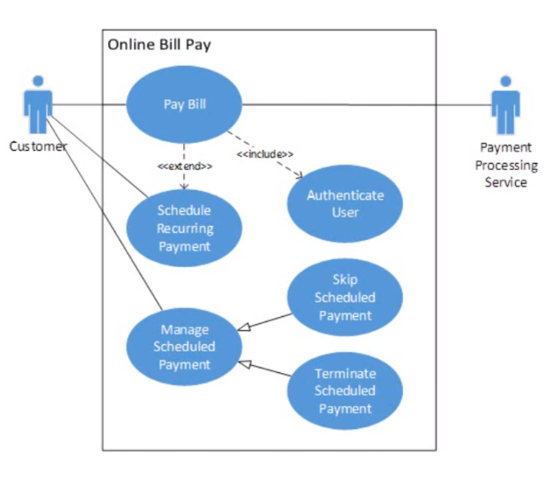
Creating Technical Posters
Making good posters
Modelling Tools
Use-cases
Use these to model human-centric processes
Particularly useful for:
Showing people-centric processes (art / production / build / QA) pipelines
Watch out for:
Detail
Legibility of text / colour combinations

Slide 25
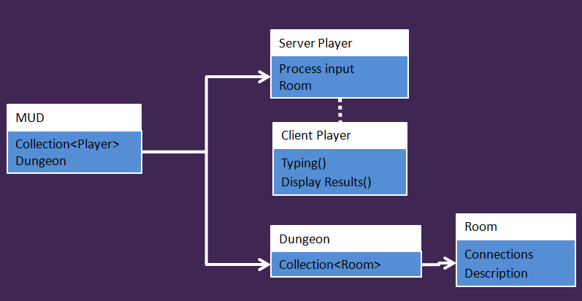
Creating Technical Posters
Making good posters
Modelling Tools
Class hierarchy / class diagram
Use this to show the relationship between classes
Particularly for inheritance & abstraction
i.e. A base class defines certain interfaces & containers
Also to show class composition
i.e. Class A has objects of type B & C in it
Guitar
String
Fretboard
String[6]
Root Note
Root Octave
Collection<Buttons>
Guitar
Button
Update()
Draw()
Key Button
Mode Button
Mode
Key Info
Mode Info
Name
Sequence

Slide 26
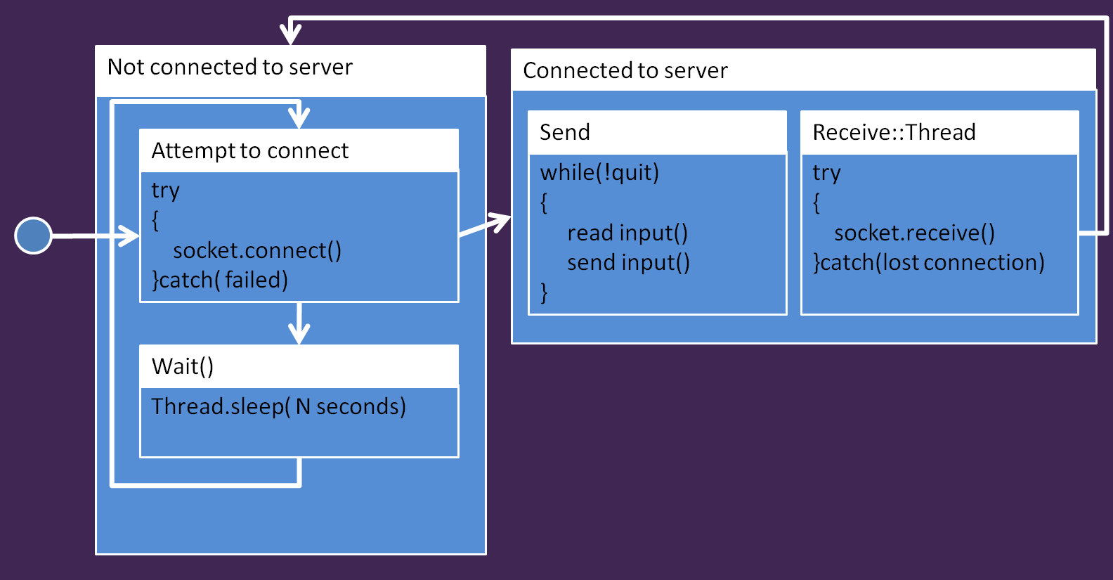
Creating Technical Posters
Making good posters
Modelling Tools
State Machine / State Diagram
Use this to show the high-level states within an application
What functions a system will implement
How control flow moves between states
Particularly useful for:
Game states
Baddie / AI states
UI flow
Attract
Start Game
Create Wave
Place Ship
Play
End of Wave
Game Over

Slide 27
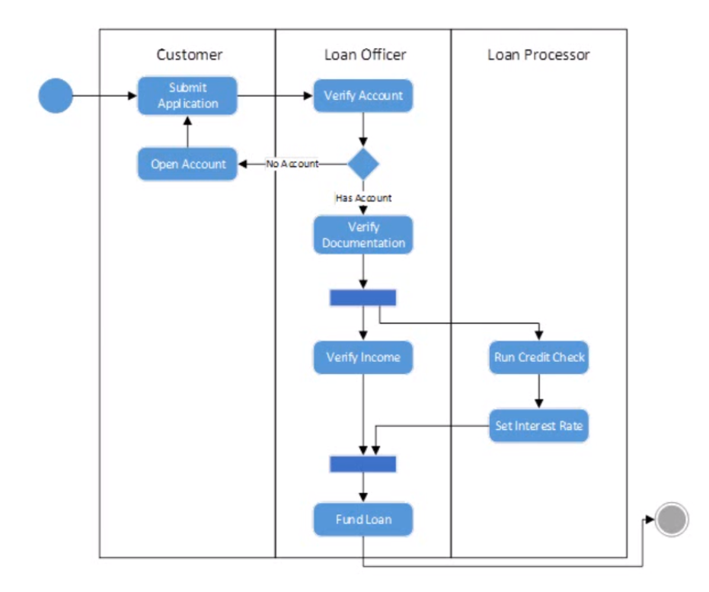
Creating Technical Posters
Making good posters
Modelling Tools
Flow chart / Activity Diagram
Use this to show fairly medium-level functionality within states or functions
Particularly useful for:
Showing control flow between objects / systems
Functionality in functions / procedures without requiring the detail of pseudo code

Slide 28
Creating Technical Posters
Making good posters
Modelling Tools
Pseudo code
Use this to show low-level functionality within functions / classes
Particularly useful for:
Functionality in functions / procedures
Watch out for:
Detail
Legibility of text / colour combinations
Visual Studio error marking ;)
generateValidNotes(mode, key)
{
var valid_notes = [];
var current_note = key;
valid_notes.add(current_note );
foreach(var step in mode)
{
current_note += step;
valid_notes.add(current_note);
}
return valid_notes;
}

Slide 29
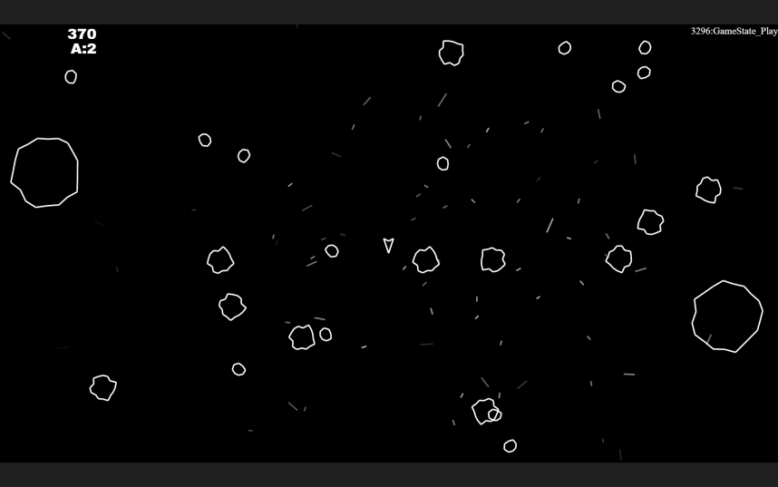
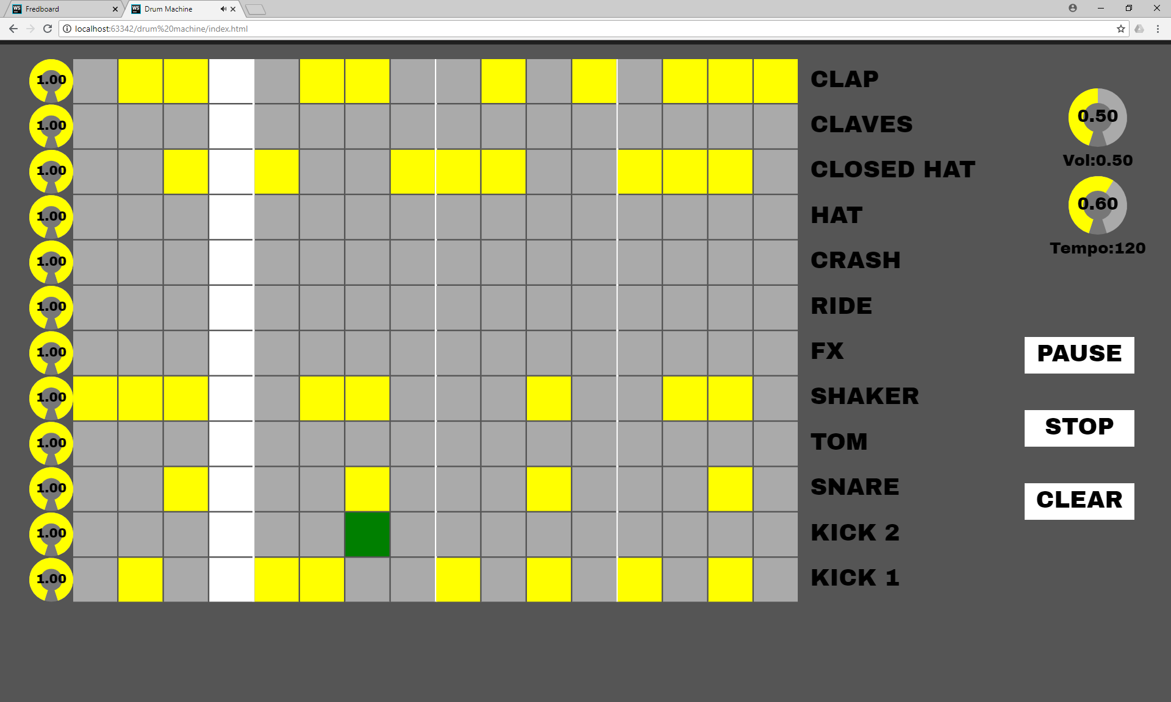
Creating Technical Posters
Making good posters
Modelling Tools
Screen caps
Use this to show the visual output of your game / application
Particularly useful:
It would take a lot of words to describe something visual
Show what your application looks like
Watch out for:
Loss of detail when shrunk to fit on poster
Darkness in printing process

Slide 30
Creating Technical Posters
Making good posters
Outcome & Impact
This section is to let the reader know what the outcome of your poster was:
Did it have a positive impact on the project
Has it opened new approaches
Etc
Being reflective and even self-critical are good
TITLE
NAME
WHAT IS THE PROBLEM
WHY IS IT AN ISSUE
WHAT IS THE SOLUTION
USE-CASES
CLASS HIERARCHY
STATE MACHINE
FLOW CHART
PSEUDO CODE
SCREEN CAPS
WHAT WORKED WELL
WHAT IS THE SCOPE FOR IMPROVEMENT(S)

Slide 31
Creating Technical Posters
Making good posters
An example
The core of the JS game engine is a state machine
It has a virtual base class of state that provides init(), update() & draw() functions that each game state derives off
State switching is done through statemachine.setState()
Can be used for other state-based things that require update() / draw() split
Why do this?
Relatively constrained issue to look at
Shows the need for structural organisation in games

Slide 32
Creating Technical Posters
Making good posters
An example
Problem definition
Looking for a solution to manage a JS application as a state of states that can be transitioned between
Why is this an issue
Software engineering says that divide and conquer is good for solving problems
Games naturally lend themselves to state-based structure
Using divide & conquer will be good for solving programming issues in a modular manner, particularly for testing
Solution description
Statemachine class to store all the game states & handle functionality
Dictionary to map state names to state functions & data
Update and draw functions to deal with separating functionality
setState() &Update() functions to manage state switching

Slide 33
Creating Technical Posters
Making good posters
An example
Modelling tools
Class diagram – show the inheritance
Pseudo code – show how state switching works
State diagram – show how a game is composed of states
Outcome and impact
This approach is good for games (lots of states)
Not so good for applications (one state)
Basic approach can be useful in other areas, though state machine methods may change

Slide 34
Sfff
STATE MACHINES FOR GAMEFLOW IN JAVASCRIPT
GARETH LEWIS
Introduction
JS and Canvas provides a light-weight development environment for creating games, but feature little functionality for managing game states within the context of a game. Hard-coding states through case or if statements is both time consuming and open to programming errors. A robust and re-usable game state framework would potentially offer a lot of advantages to developing JS games
Solution
My need for a robust game state machine came from developing an Asteroids clone for Canvas. Asteroids has a fairly simple set of game states [see state diagram below] and transitions between states which occur on user input, e.g. going from ‘attract’ mode to playing the game, or on game events, e.g. player getting killed or clearing a wave of asteroids.
class StateMachine
{
Dictionary<String,State> stateLookup;
String currentState = “”;
String pendingState = “”;
setState(state){pendingState = state;}
update()
{
if(pendingState !=== ‘’)
{
stateLookup[currentState].exit();
currentState = pendingState
stateLookup[currentState].init();
pendingState = ‘’;
}
stateLookup[currentState].update();
State 1 : State
Name
Init()
Update()
Draw()
State
StateMachine
Name
virtual Init()
virtual Update()
virtual Draw()
Dictionary<Name, State>
Init()
Update()
Draw()
State 2 : State
Name
Init()
Update()
Draw()
Class hierarchy of game state machine
State-switching pseudo code
The structural solution to was to create an abstract game state class and derive all the actual game states from it [see class hierarchy above]. These states were stored in the state machine class as a dictionary of state names to base states. The state machine was made part of a Game singleton class giving the entire game code access to the state machine to allow global state changing from any point within the codebase, particularly from within a state’s update() function as this was where most state changes originated.
Runtime state management and state changing occurred through the interaction of the setState() and update() functions in the State Machine class. The state switching pseudo code [above] details a lightweight setState() function that just records a state change request. This used by the update()function to determine if a state change is required. If so, the current state is exited, the state name is changed and the new state runs its init function before returning to the standard path, which will then call the state’s update().
Attract
Conclusions
This approach has worked successfully on the Asteroids game I developed in JS/Canvas. Breaking the game down into a set of states has allowed me to keep a close relationship between game design, as the state diagram, and the code that was implemented from those states.
State transitions have been made fairly trivial as just a function that is called with a desired state label.
The one downside I discovered through testing and debugging was that if multiple state change requests occurred in an update, only the last request would be acted on, though this has currently been addressed with some questionable code, I need to address this with a better solution.
This approach has shown me that re-usable state management could be applied in other game programming areas and I’m keen to look at baddie AI and UI work in the next instance.
Start Game
Create Wave
Place Ship
Play
End of Wave
Game Over
State diagram of Asteroids game

Slide 35
Questions

